Slide 1
Keyboarding Vocab
And Injury Prevention
CSA1 Keyboarding

Slide 2
1.01 Vocabulary Terms
Posture: The way the typist sits; the way the typist arms, wrists, fingers, legs, and feet are placed
Work area: Arrangement of the keyboard, copy, mouse, and other materials on the desk

Slide 3
1.01 Vocabulary Terms
Technique: The form and keying style that a typist uses while operating the keyboard
Touch-Method: To key by touch rather than by the hunt-and-peck method

Slide 4
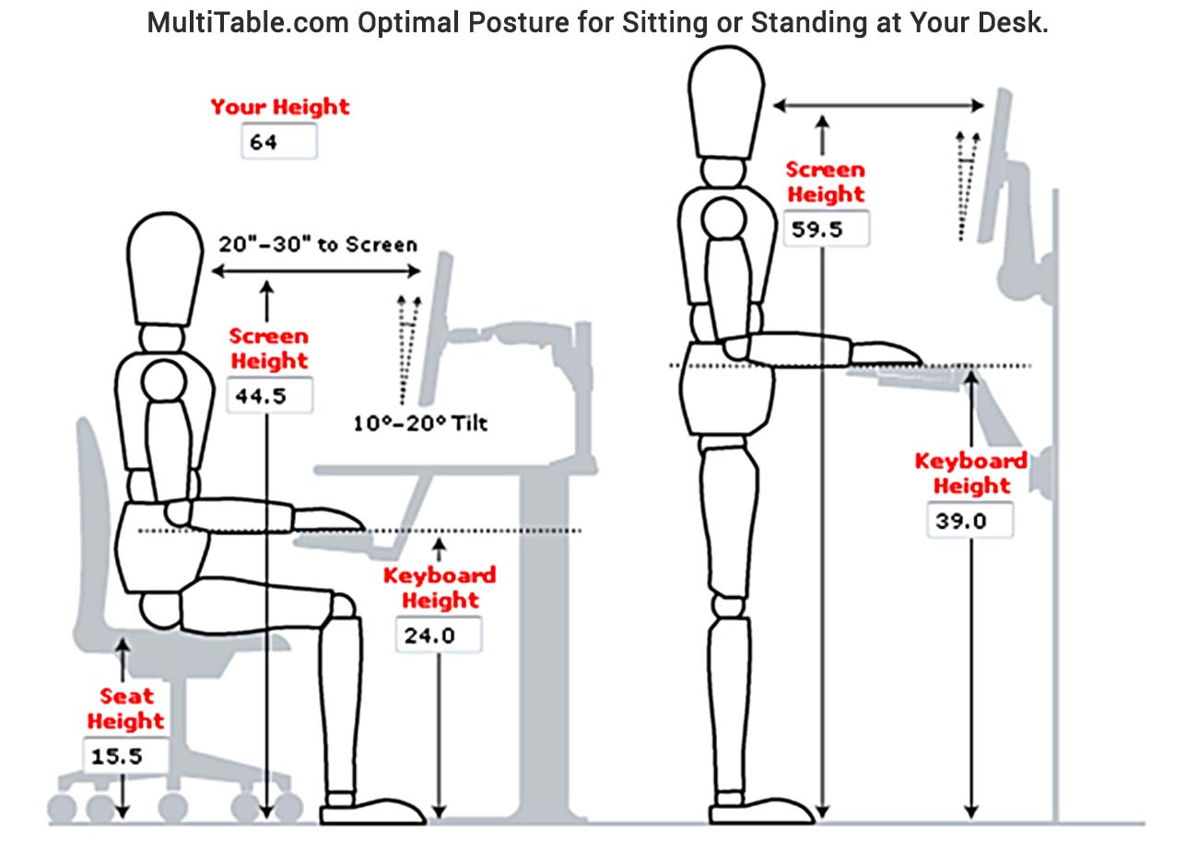
Setting Up a Comfortable, Healthy Workstation
Ergonomics: an applied science concerned with designing and arranging things people use so that the people and things interact most efficiently and safely

Slide 5
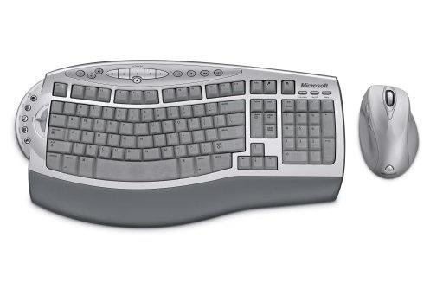
Ergonomics
Ergonomics – the study of how a person’s work environment and tools affect the person
Ergonomists design workspaces and tools that help people do their jobs and use their tools comfortably and safely
Examples:
Ergonomic keyboard and mouse
Ergonomic desk chair
Notes:
5

Slide 6
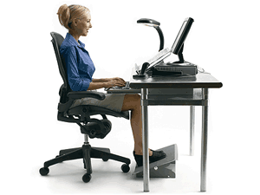
Workstation Arrangement
Keyboard directly in front of your chair
Keyboard even with the edge of the table/desk
Tilt the monitor for easy viewing
Place the copy to the right of the keyboard
Elevate your feet if they do not touch the floor

Slide 7
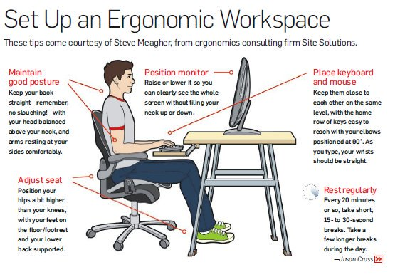

Slide 8
Repetitive Strain Injury (RSI)
Repetitive Strain Injury results from forceful, awkward, and/or repetitive use of your limbs, producing damaged muscles, tendons, and nerves.
Tendonitis is the most common example of RSI, while carpal tunnel syndrome is a more rare and serious disorder. RSI occurs frequently among computer users, musicians, lab workers, and other people with occupations requiring repetitive movements.
tingling or loss of sensation in fingers, inability to grasp objects between thumb and fingers, decrease in the size of hand muscles, and pain in the wrist, elbow, shoulder, or neck.
If you’re suffering from these symptoms, get immediate medical attention to increase the chances of quick and total recovery.

Slide 9
Computers and Eyestrain
Eyestrain can lead to general fatigue, increased nearsightedness, and a decrease in overall efficiency.
Everyone is at risk for eyestrain, especially those who work at a computer for more than three hours a day.
What are the symptoms of eyestrain?
headache
dry eyes, "gritty" feeling in the eyes
blurred vision
eye fatigue
changes in color perception

Slide 10
More on eyestrain...
Eyestrain is primarily a result of overworking the muscles of the eyes.
Four main reasons for eye strain
Evolutionary difference between eyes designed for 3D vision at a distance and 2D monitors up close
Glare on screens requires eyes to work harder to focus and see clearly.
Monitor position may not be in natural range of vision
Rapid, repetitive eye movements on screen and between screen and copy

Slide 11
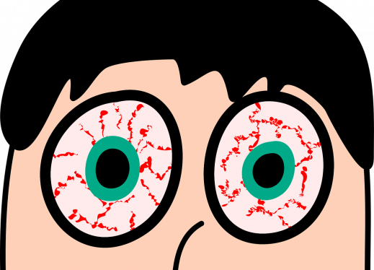
Ways to address eyestrain…
Strategies to improve eye strain
Take breaks and allow eyes to focus on things at a distance
Reduce glare on screens (angle of screen, lighting, films applied to screens)
Adjust monitor height to natural range of vision
Use a copy holder to hold copy even with monitor height

