Slide 1
Proper Keyboarding Techniques
Ms. Salvador
Adapted from presentation by: Nadine Bunnell, Keyboarding Specialist Used with permission.nbunnell@usoe.k12.ut.us
Utah State Office of Education, Curriculum & Instruction, Applied Technology Education www.usoe.k12.ut.us/ate/keyboarding/key.htm

Slide 2
Bad Habits in Typing
Slouching
Reaching too far for the keyboard or mouse.
Leaning your hand on the keyboard or the wrist support.
Bending your wrists forward, back, left, or right
Pounding the keys
Raising your elbows or shoulders
Keying with the wrong fingers

Slide 3
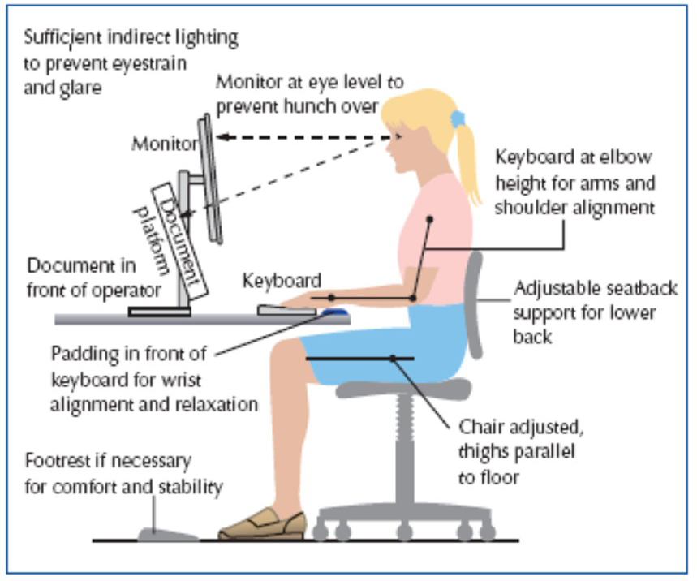
Posture & Position at the Keyboard
Shoulders down, arms relaxed
Elbows level with the keyboard
Feet and lower back supported

Slide 4
Posture & Position at the Keyboard
Eyes level with the text on the monitor

Slide 5
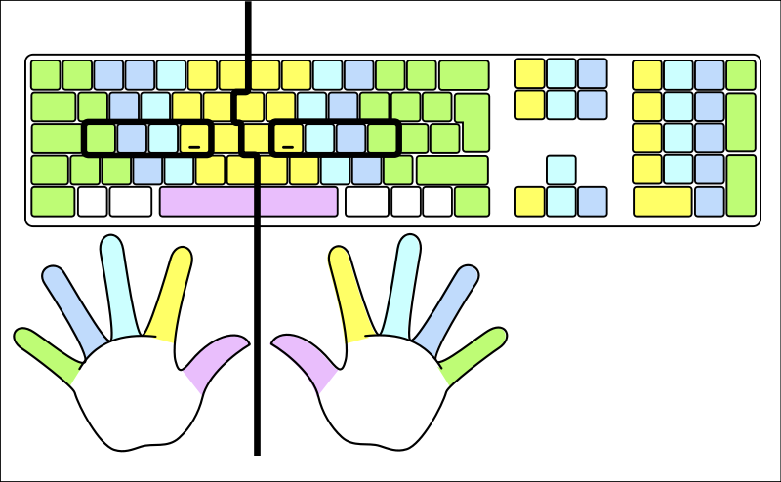
Where do I place my fingers?

Slide 6
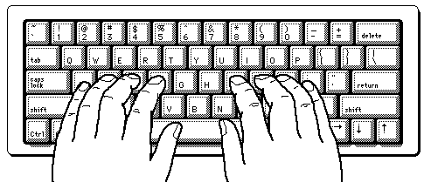
Posture & Position at the Keyboard
Fingers curved

Slide 7
Posture & Position at the Keyboard
Wrists off the keyboard

Slide 8
Correct Keying Checklist
Center your body on the J key, about a hand’s length from the keyboard and directly in front of the monitor.
Hold your head straight over your shoulders, without straining forward or backward.
Position the monitor at eye level about arm’s length away so you look down about 10 degrees.
Elongate and relax your neck.
Keep your shoulders down.
Tilt your keyboard slightly down toward the monitor. Flatten the kickstand on the back of your keyboard. This keeps your wrists neutral and your fingers relaxed and curled.

Slide 9
Correct Keying Checklist, Part 2
Adjust your chair and keyboard so your elbows bend at right angles.
Keep your arms close to your sides but free to move slightly
Keep your wrists relaxed and straight in a “neutral” position.
Keep your back upright or tilted slightly forward from the hips. Keep the slight natural curve of your lower back.
Keep your knees slightly lower than your hips.
Adjust your chair so your feet are well supported. Use a footrest , if necessary.
Take breaks every 20-30 minutes and stretch!

Slide 10
Benefits of Keying Correctly
Increase your speed.
Increase your efficiency, making fewer errors.
Increase your effectiveness because you can see the screen or look at your work papers while your hands are free to type.
Avoid Carpal Tunnel Syndrome.

Slide 11
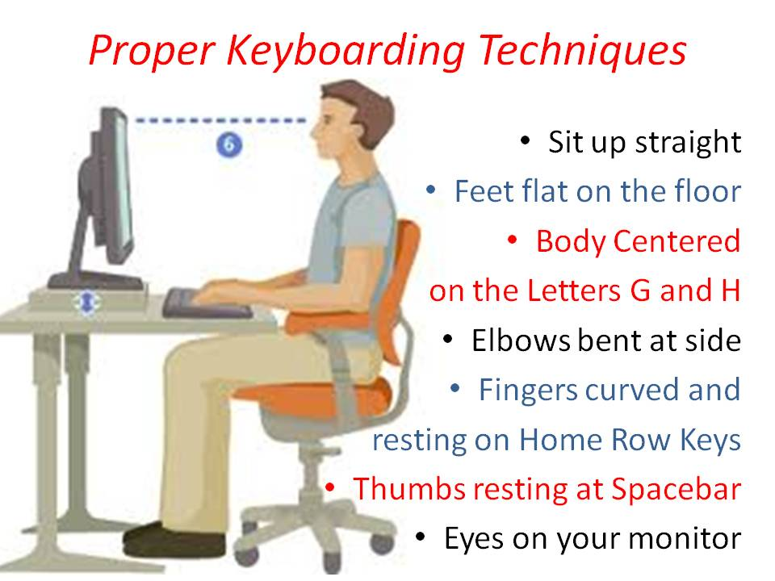
Remember
Technique
Accuracy
Speed

