Slide 1
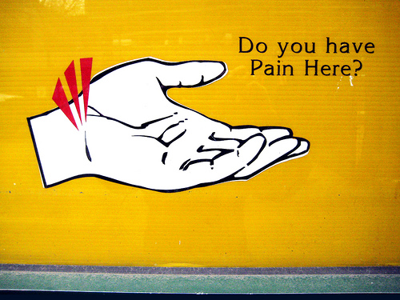
Carpal Tunnel Syndrome

Slide 2
Do you often feel a numbness or tingling in your hand… especially at night?
Maybe you experience clumsiness in handling objects and sometimes you feel a pain that goes up the arm to as high as the shoulder.
These may be the symptoms of
carpal tunnel syndrome
Let’s learn more about this common health problem

Slide 3
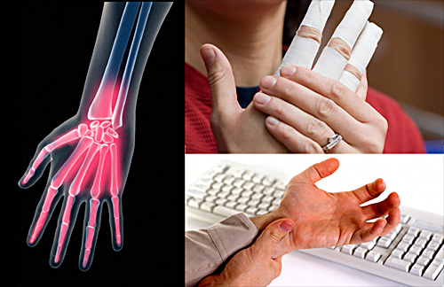
What is Carpal Tunnel Syndrome ?
Carpal tunnel syndrome is a condition affecting the hand and wrist

Slide 4
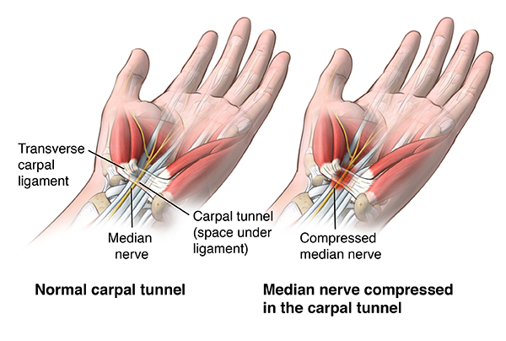
Carpal Tunnel Syndrome (CTS)
CTS involves swelling of the tendons located inside the tunnel space, resulting in pressure on the median nerve

Slide 5
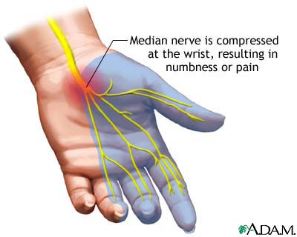
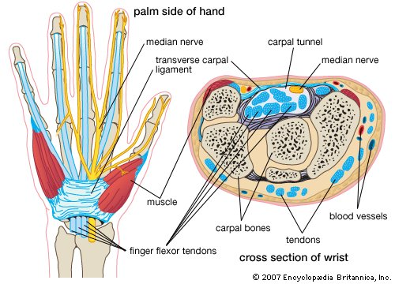
Carpal Tunnel Syndrome
The median nerve travels from the forearm into your hand through a “tunnel” in your wrist.

Slide 6
The combination of these symptoms is called carpal tunnel syndrome
Pressure on the median nerve can result in: sensations of numbness, tingling, pain and clumsiness of the hand.

Slide 7
How Does Carpal Tunnel Syndrome Develop?
The tendons of the hands are wrapped with a lining that produce a slippery fluid (synovium) which in turn, lubricates the tendons
With repetitive movement of the hand, the lubrication system may malfunction
This reduction in lubrication results in inflammation and swelling of the tendon area
Repeated episodes of swelling cause thick tissue to form and prevents tendon movement

Slide 8
How Common A Problem is Carpal Tunnel Syndrome?
The dominant hand is usually affected first and produces the most severe pain.
Women are three times more likely than men to develop carpal tunnel syndrome, perhaps because the carpal tunnel itself may be smaller in women than in men.
Especially common in those performing assembly line work - manufacturing, sewing, finishing, cleaning, and meat, poultry, or fish packing.
CTS is three times more common among assemblers than among data-entry personnel
A recent survey of 400 American hand surgeons reported that each surgeon performs over 65 operations for carpal tunnel syndrome every year

Slide 9
What causes it? There are two basic categories of causes
Repetitive Task | Profession
Grabbing & tugging cloth | Tailor, sewer
Handling objects on conveyor belt | Assembly-line worker
Hand weeding | Gardener
Using spray gun | Painter
Knitting | Homemaker
Turning keys | Locksmith
Typing | Clerical worker
Using scanner at checkout counter | Cashier
Scrubbing | Janitor
Stringed instruments | Musician
Work Related Causes

Slide 10
Non-Work Related Causes
Arthritis
Diabetes
Thyroid gland imbalance
Gout
Broken or dislocated bones of the wrist
Wrist cysts
* Most cases have no known cause

Slide 11
What Are the Symptoms of Carpal Tunnel Syndrome?
Tingling of the thumb, index, middle & ring fingers.
Especially at night & after using hands
Relieved by shaking, hanging or massaging your hands
Dropping objects, inability to keep or count change with the affected hand

Slide 12
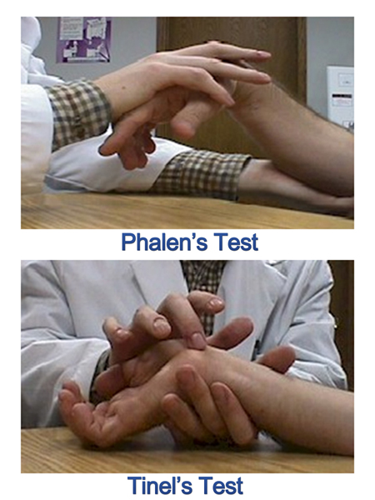
How is it diagnosed?
Tinel’s Test:
Doctor taps the median nerve at the wrist producing a tingling feeling…like hitting your funny bone)

Slide 13
Phalen’s Test:
Symptoms can be reproduced when wrists are kept down in a bent position for one minute

Slide 14
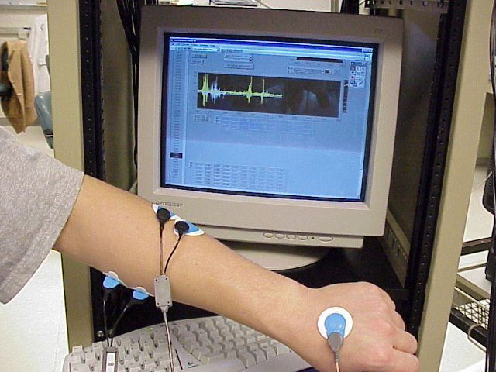
Electromyography “The Golden Standard”
Electrodes are placed on the forearm and a mild electrical current is passed through the arm.
Measurement of how fast & how well the median nerve responds indicates if there is damage to the nerve.

Slide 15
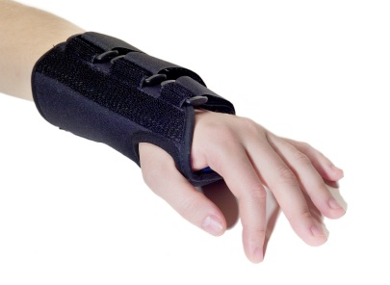
Treatment Options?
Mild Cases:
Splint (usually worn at night) to prevent the wrist from bending. Relieves swelling through rest.
Medications: Oral anti- inflammatories. The swollen membranes are reduced

Slide 16
Treatment for Severe Cases
Cortisone injection: Medication surrounds the swollen membranes & tendons… shrinking them (effective when diagnosis is made early)
Surgery: under local anesthetic. Relieves pressure on the median nerve. Usually considered day surgery.

Slide 17
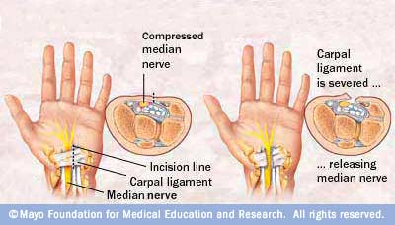
Open Carpal Tunnel Release
The surgeon makes a 2-5 inch incision in the lower palm and wrist area. The carpal ligament is opened. This frees the median nerve. The incision is closed with stitches. A bulky bandage is applied to the wound, with care taken to ensure that finger movement is NOT restricted.

Slide 18
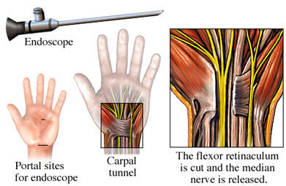
Endoscopic Carpal Tunnel Release
A tiny, ½-inch incision is made on the palm side of the wrist. A miniature fiber optic camera is passed through. This camera allows the surgeon to view the inside of the carpal tunnel. Another tiny incision is made. Surgical tools are passed in. While looking at the monitor, these instruments are used to release the carpal ligament and free the median nerve. After the camera and instruments are removed, a few stitches are necessary to close the incisions. A bulky bandage is placed over the wounds.

Slide 19
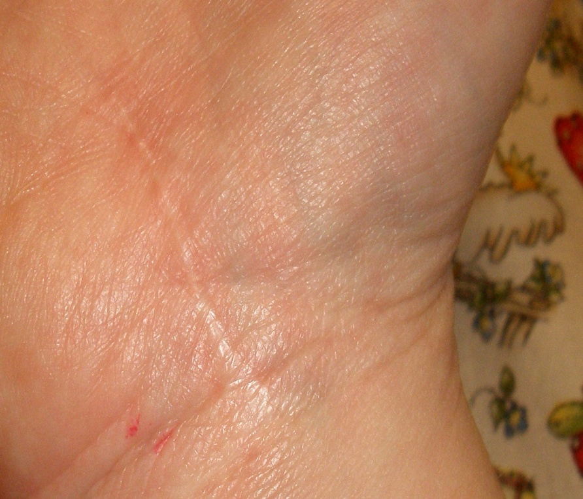
What Can I Expect After the Surgery?
Tenderness at incision site until healing complete
Symptom relief immediately or shortly afterwards
Numbness may remain for a period of time in older individuals or more severe cases

Slide 20
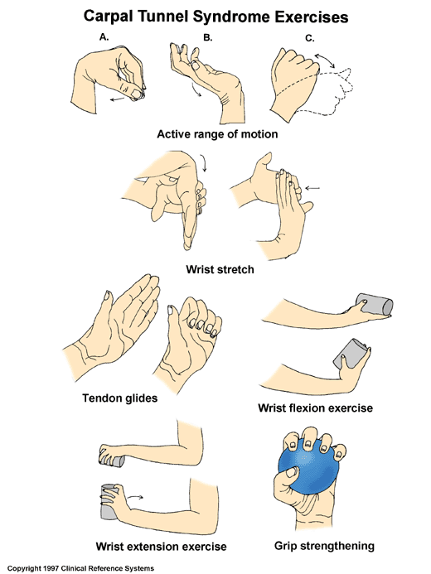
Exercises
Post Surgery
Physical activities can be resumed only after a few weeks & for some a few months
Exercises will be given in order to build muscle strength, joint flexibility of hand and wrist

Slide 21
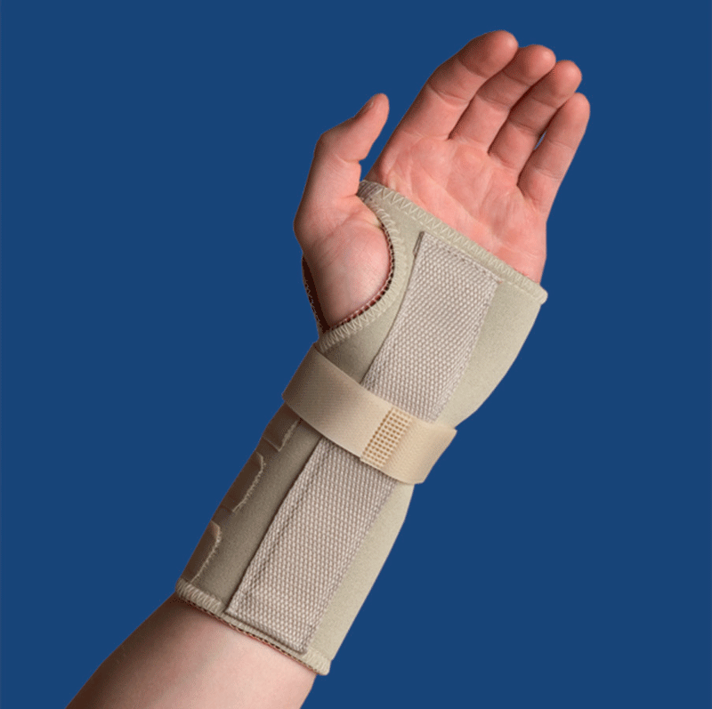
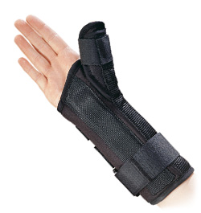
Outcome
You may have to wear a brace or splint for several weeks after surgery.
Complete recovery may take 4-6 weeks or longer. The numbness or tingling in your hand and fingers usually improves rather quickly. Your grasp strength will very slowly begin to improve.

Slide 22
Surgery Success rate
1st surgery 50 – 60%
2nd surgery 35 – 45%
Carpal Tunnel Syndrome comes back for over 85% of people within 6 months to 8 years of a successful surgical procedure.

Slide 23
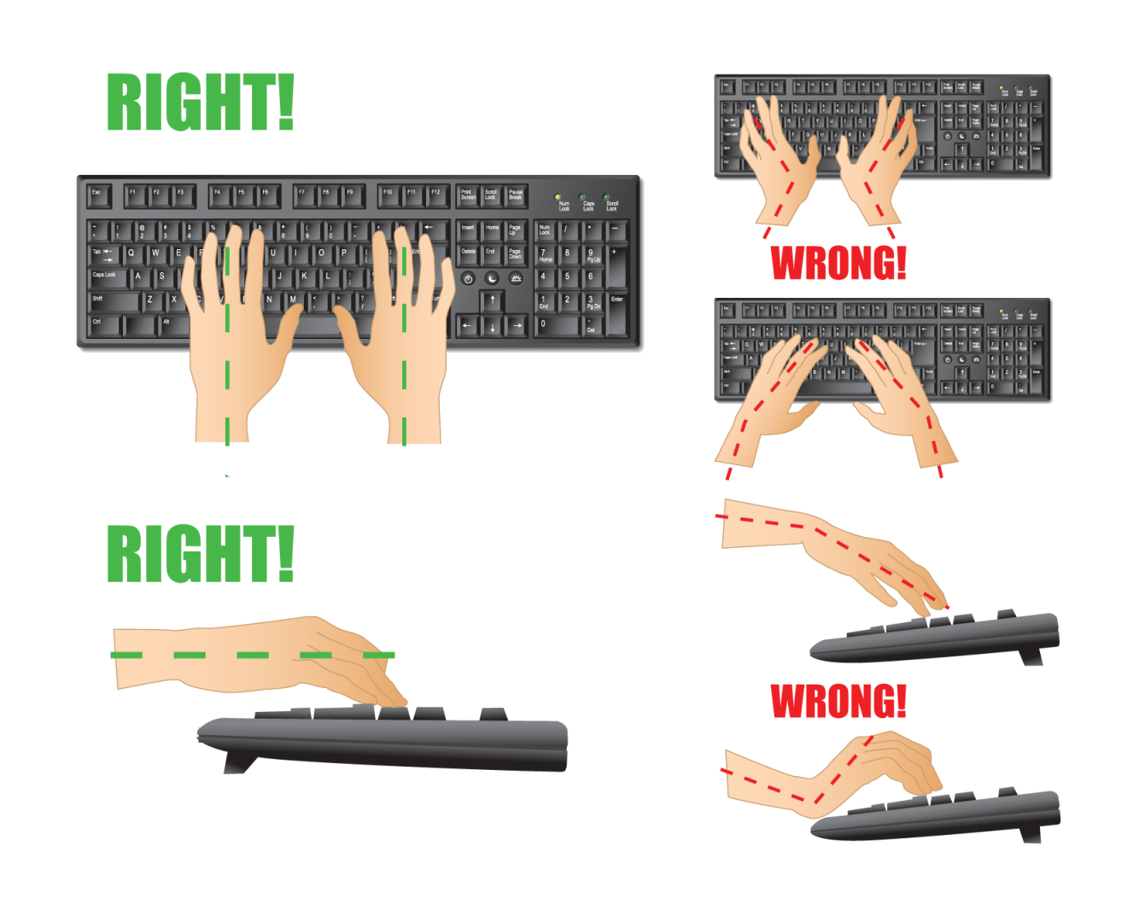
Remember…

